Slide 1
Overview Introduction to Operating Systems
Some of the following slides are adapted from Matt Welsh, Harvard Univ.

Slide 2
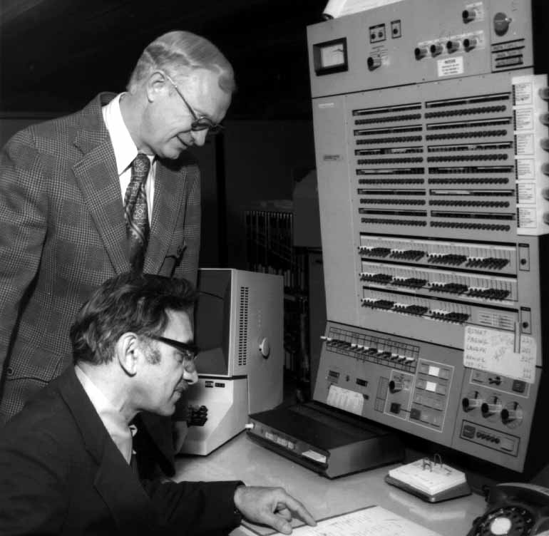
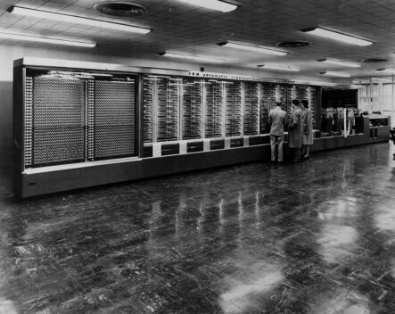
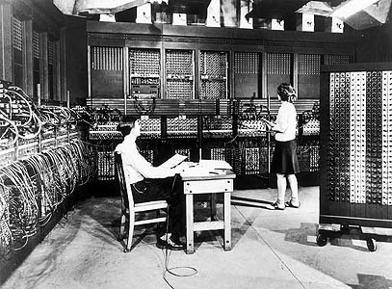
In the Beginning…
There was no OS – just libraries
Computer only ran one program at a time, so no need for an OS
Programming through wiring..
Harvard Mark I, 1944
ENIAC, 1945
IBM 360, 1960's

Slide 3
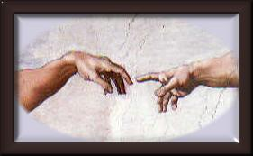

Slide 4
In the Beginning…
There was no OS – just libraries
Computer only ran one program at a time, so no need for an OS
And then there were batch systems
Programs printed on stacks of punchhole cards
OS was resident in a portion of machine memory
When previous program was finished, OS loaded next program to run

Slide 5
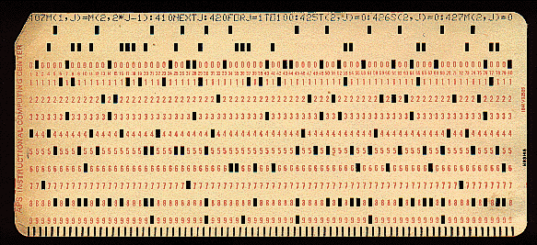
Punch Card

Slide 6
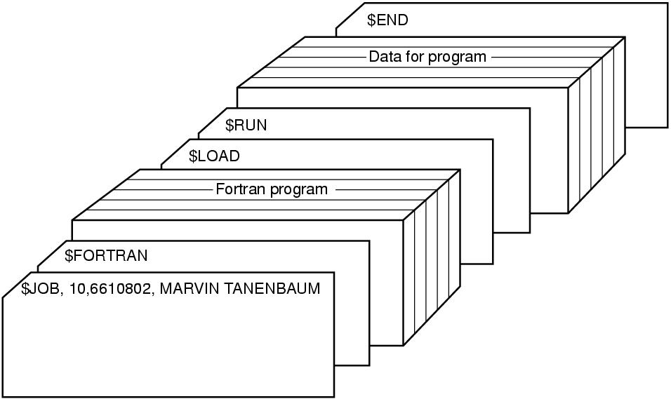
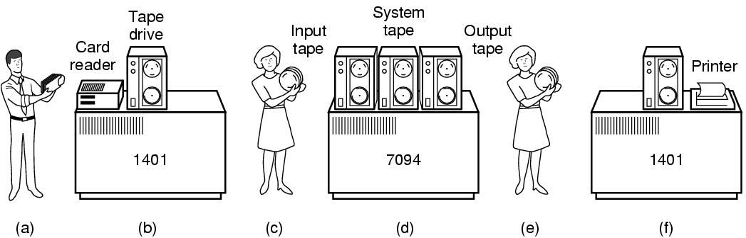
In the Beginning…
There was no OS – just libraries
Computer only ran one program at a time, so no need for an OS
And then there were batch systems
Programs printed on stacks of punchhole cards
OS was resident in a portion of machine memory
When previous program was finished, OS loaded next program to run

Slide 7
In the Beginning…
There was no OS – just libraries
Computer only ran one program at a time, so no need for an OS
And then there were batch systems
Programs printed on stacks of punchhole cards
OS was resident in a portion of machine memory
When previous program was finished, OS loaded next program to run
Disk spooling
Disks were much read stack onto disk while previous program is running
With multiple programs on disk, need to decide which to run next!
But, CPU still idle while program accesses a peripheral (e.g., tape or disk!)‏

Slide 8
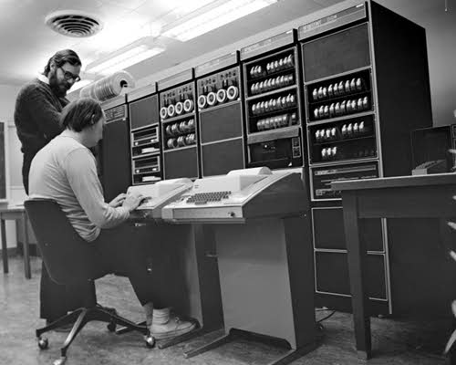
Multiprogramming
To increase system utilization, multiprogramming OS’s were invented
keeps multiple runnable jobs loaded in memory at once
Overlaps I/O of a job with computing of another
While one job waits for I/O to compile, CPU runs instructions from another job
To benefit, need asynchronous I/O devices
need some way to know when devices are done performing I/O
Goal: optimize system throughput
perhaps at the cost of response time…
Dennis Ritchie and Ken Thompson at a PDP11, 1971

Slide 9
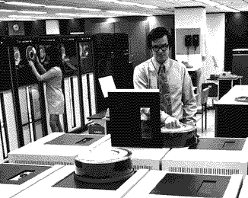
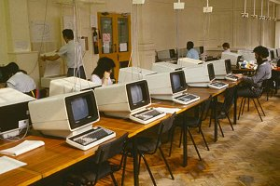
Timesharing
To support interactive use, timesharing OS's were created
multiple terminals connected to one machine
each user has illusion of entire machine to him/herself
optimize response time, perhaps at the cost of throughput
Timeslicing
divide CPU fairly among the users
if job is truly interactive (e.g. editor), then can switch between programs and users faster than users can generate load
MIT Multics (mid-1960’s) was the first large timeshared system
nearly all modern OS concepts can be traced back to Multics

Slide 10
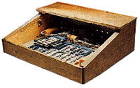
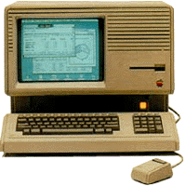
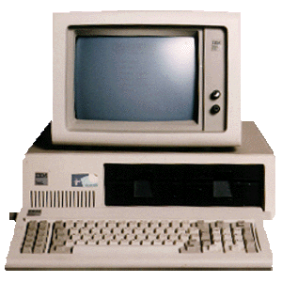
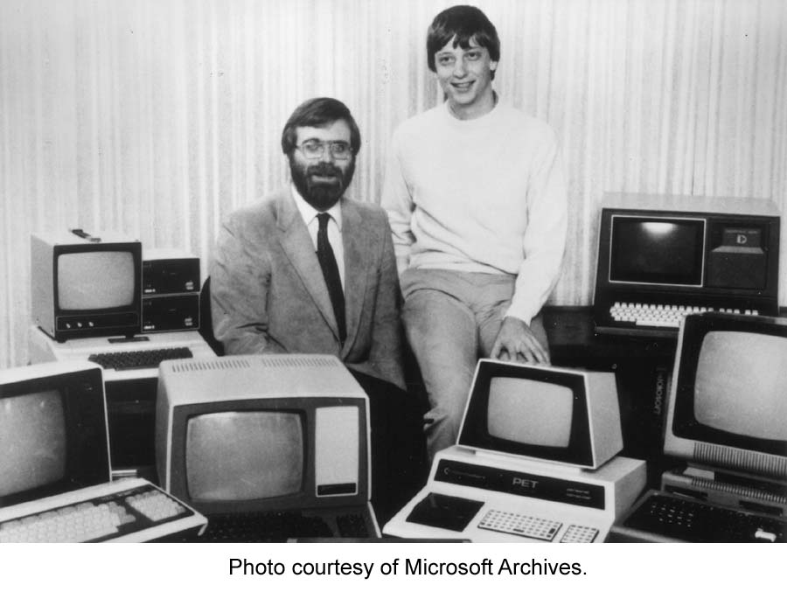
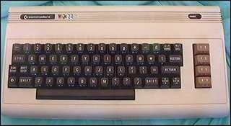
Personal Computing
Apple I, 1976
Totally changed the computing industry.
CP/M: First personal computer OS
IBM needed OS for their PCs, CP/M behind schedule
Bill Gates to the rescue: Bought 86-DOS and made MS-DOS
DOS is basically a subroutine library!
Many popular personal computers follow
Apple, Commodore, TRS-80, TI 99/4, Atari, etc...
Apple LISA, 1983
IBM PC, 1981
Bill Gates and Paul Allen, c.1975
Commodore VIC-20

Slide 11
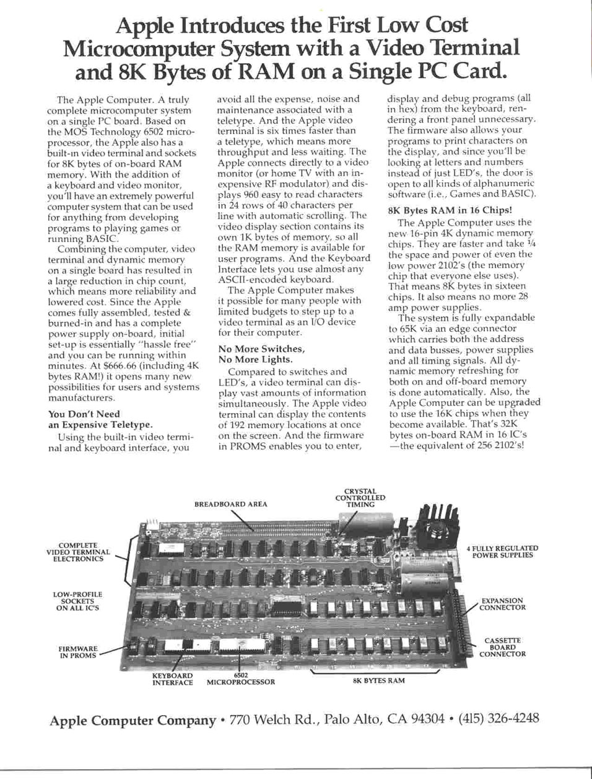

Slide 12
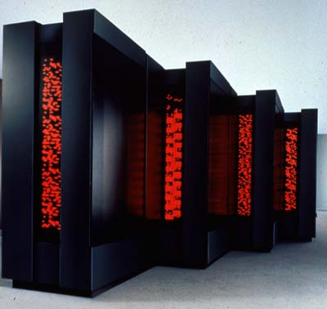
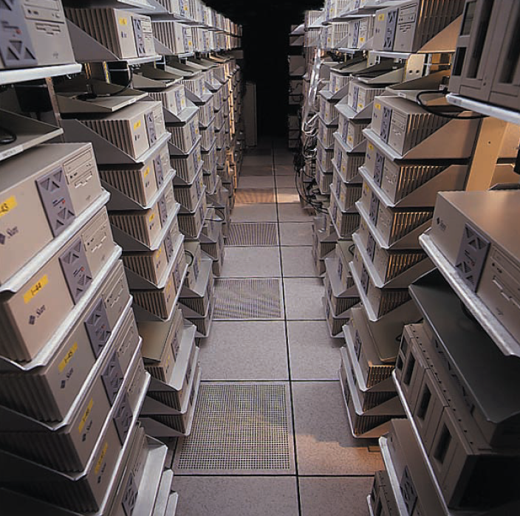
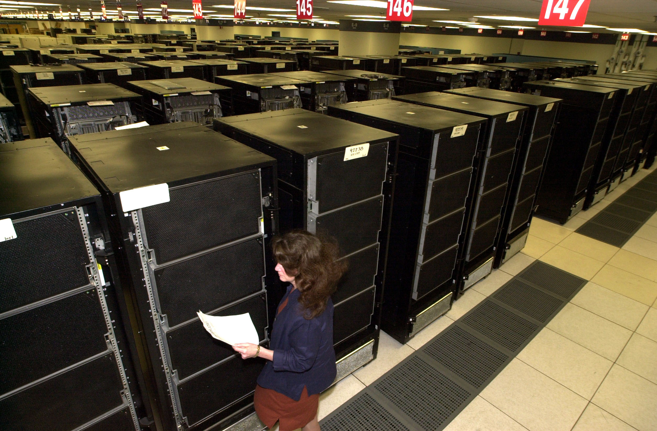
Parallel Computing and Clusters
High-end scientific apps want to use many CPUs at once
Parallel processing to crunch on enormous data sets
Need OS and language primitives for dividing program into parallel activities
Need OS primitives for fast communication between processors
degree of speedup dictated by communication/computation ratio
Many kinds of parallel machines:
SMPs: symmetric multiprocessors – several CPUs accessing the same memory
MPPs: massively parallel processors – each CPU may have its own memory
Clusters: connect a lot of commodity machines with a fast network

Slide 13
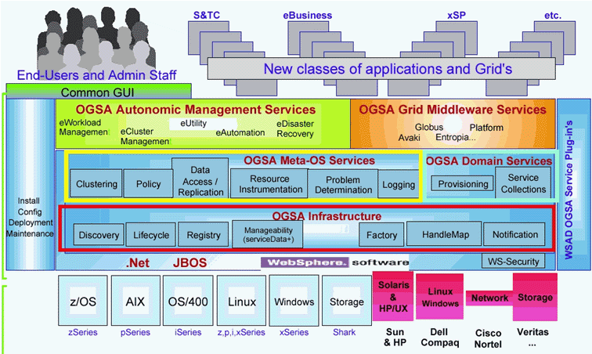
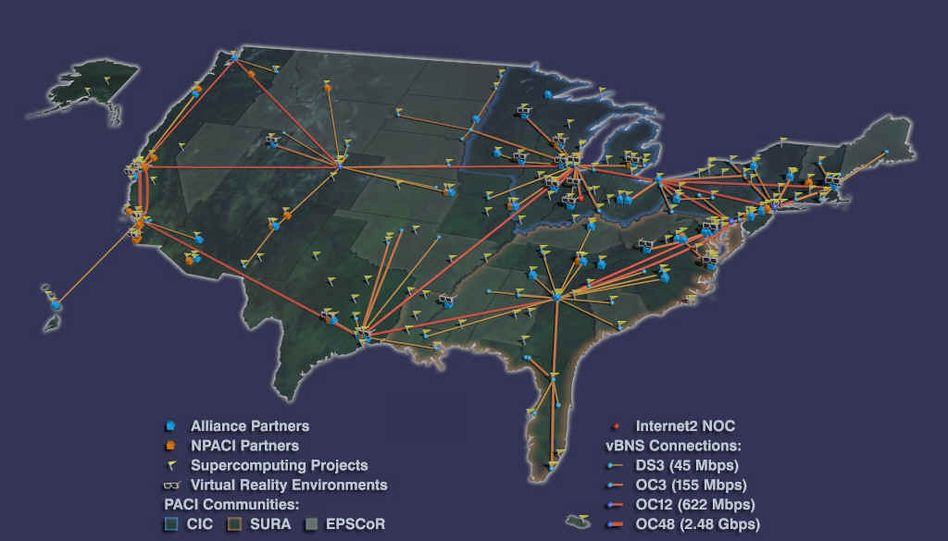
Distributed OS
Goal – Make use of geographically distributed resources
workstations on a LAN
servers across the Internet
Supports communication between applications
interprocess communication (on a single machine):
message passing and shared memory
networking procotols (across multiple machines):
TCP/IP, Java RMI, .NET SOAP
“The Grid”, .NET, and OGSA
Idea: Seamlessly connect vast computational resources across the Internet

Slide 14
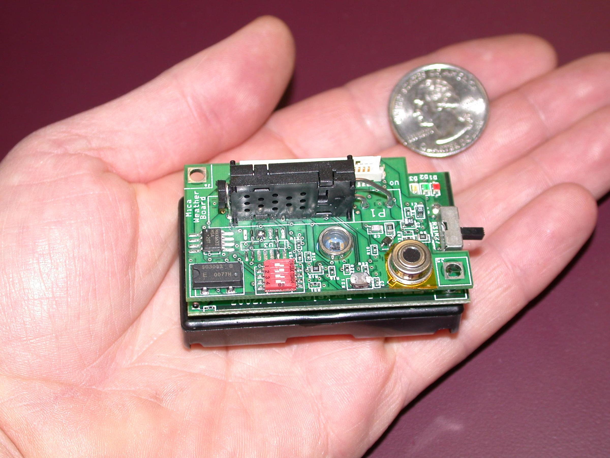
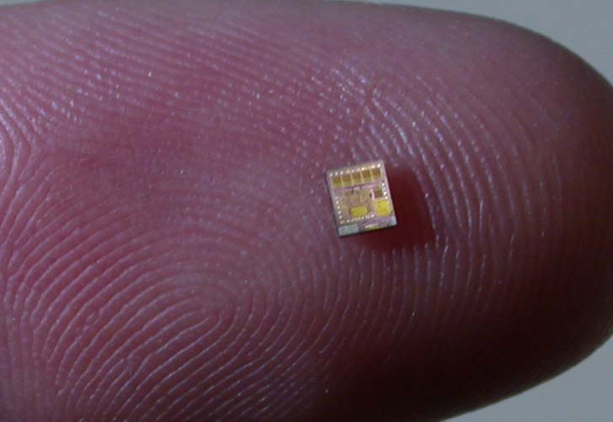
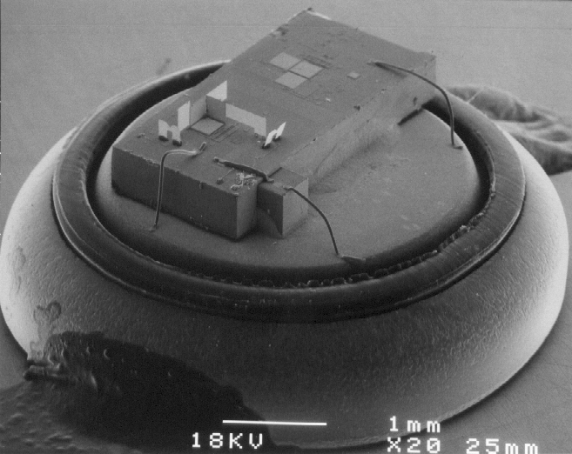
Embedded OS
The rise of tiny computers everywhere – ubiquitous computing
Processor cost low enough to embed in many devices
PDAs, cell phones, pagers, ...
How many CPUs are in your car? On your body right now?
Gets more interesting with ubiquitous networking!
Wireless networks becoming pervasive
Sensor networks are an exciting new direction here
Little “motes” with less 4KB of RAM, some sensors, and a radio
Typically very constrained hardware resources
slow processors
very small amount of memory (e.g. 8 MB)‏
no disk – but maybe quasi-permanent storage such as EEPROM

